Slide 1
Impact of Covid vaccination
Following the Data

Slide 2
Comparing decline in Birth rate and Live Births

Slide 3
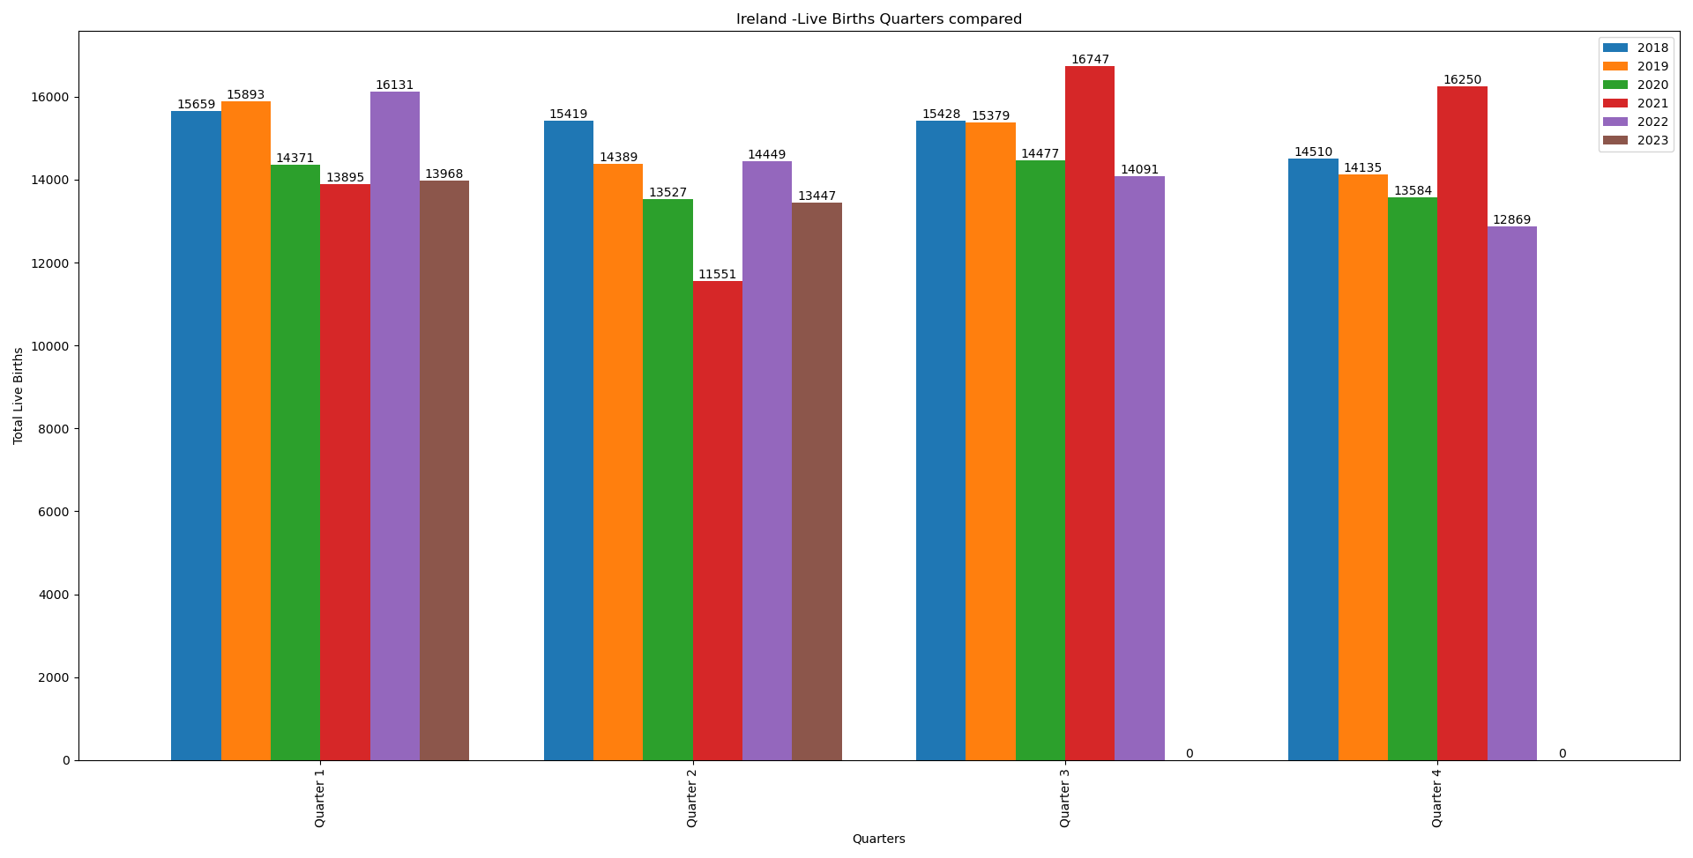
Ireland
Started vaccine rollout from May-2021 for Everyone aged 18-64

Slide 4
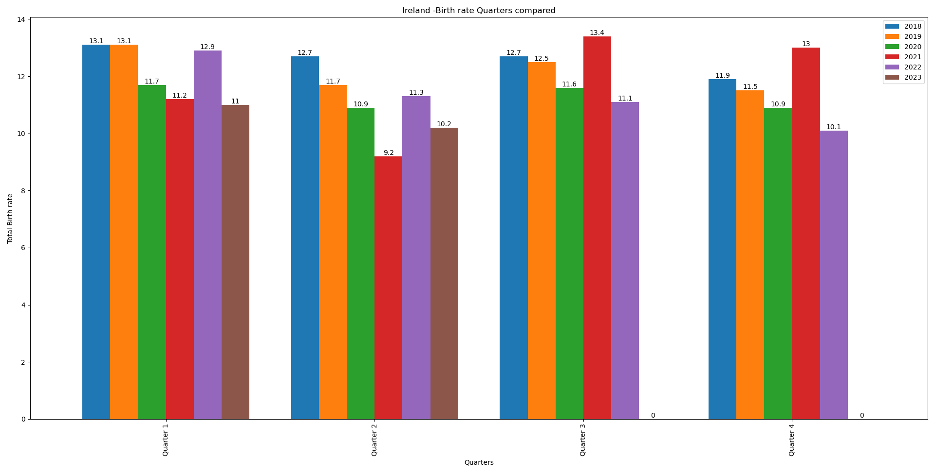
Ireland
Started vaccine rollout from May-2021 for Everyone aged 18-64

Slide 5
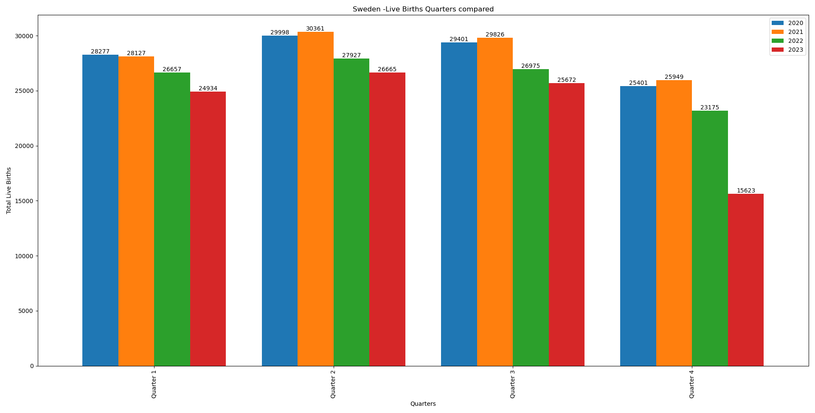
Sweden
Started vaccine rollout from Jun-2021 for Everyone aged 18-64

Slide 6
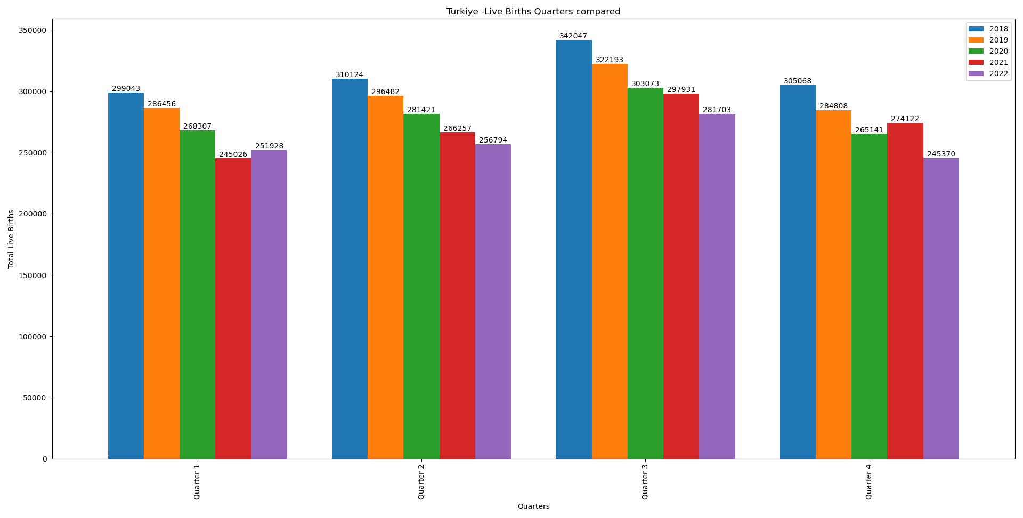
Turkey
Started vaccine rollout from July-2021 for Everyone aged 18-64

Slide 7
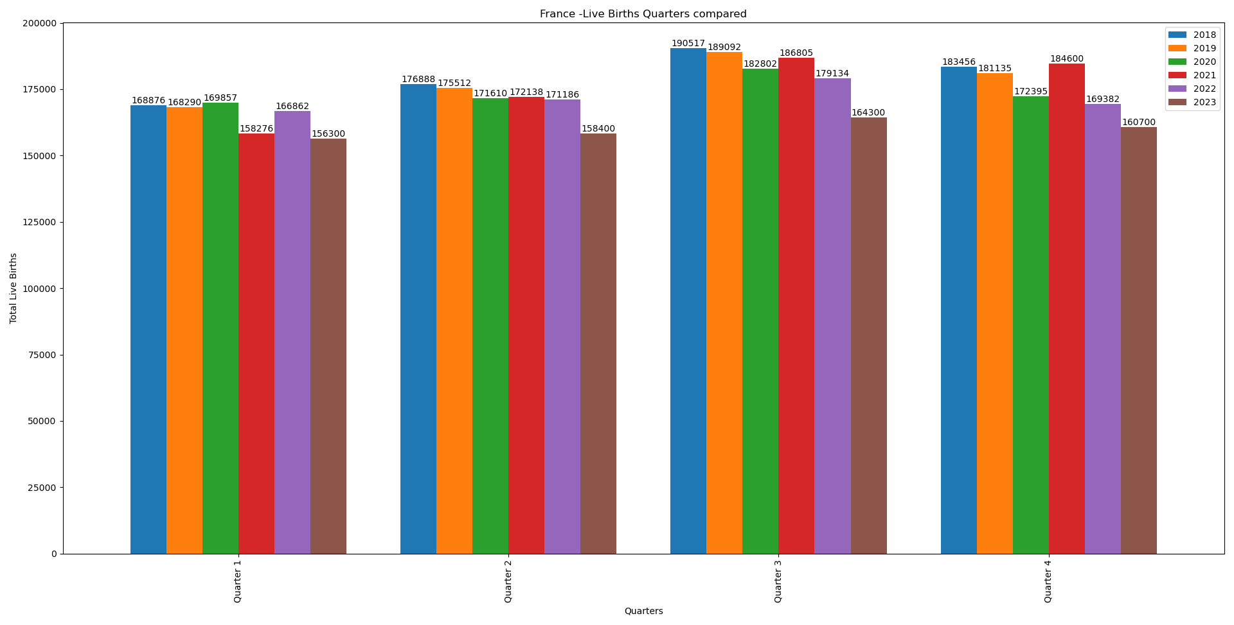
France
Started vaccine rollout from april-2021 for Everyone aged 18-64
A dip can be seen in the months of feb, march and april

Slide 8
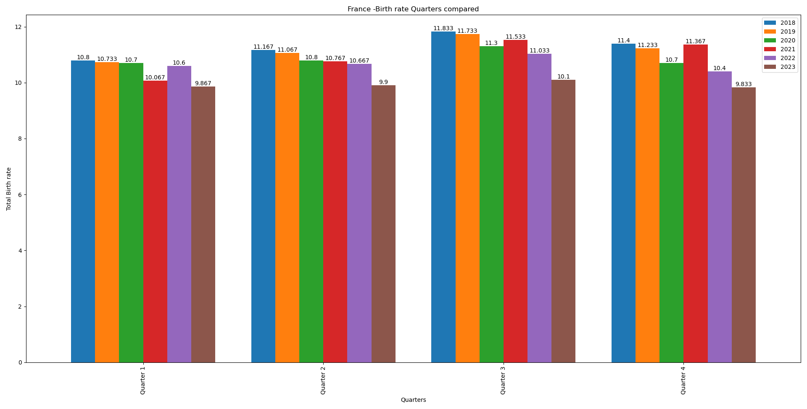
France
Started vaccine rollout from april-2021 for Everyone aged 18-64

Slide 9
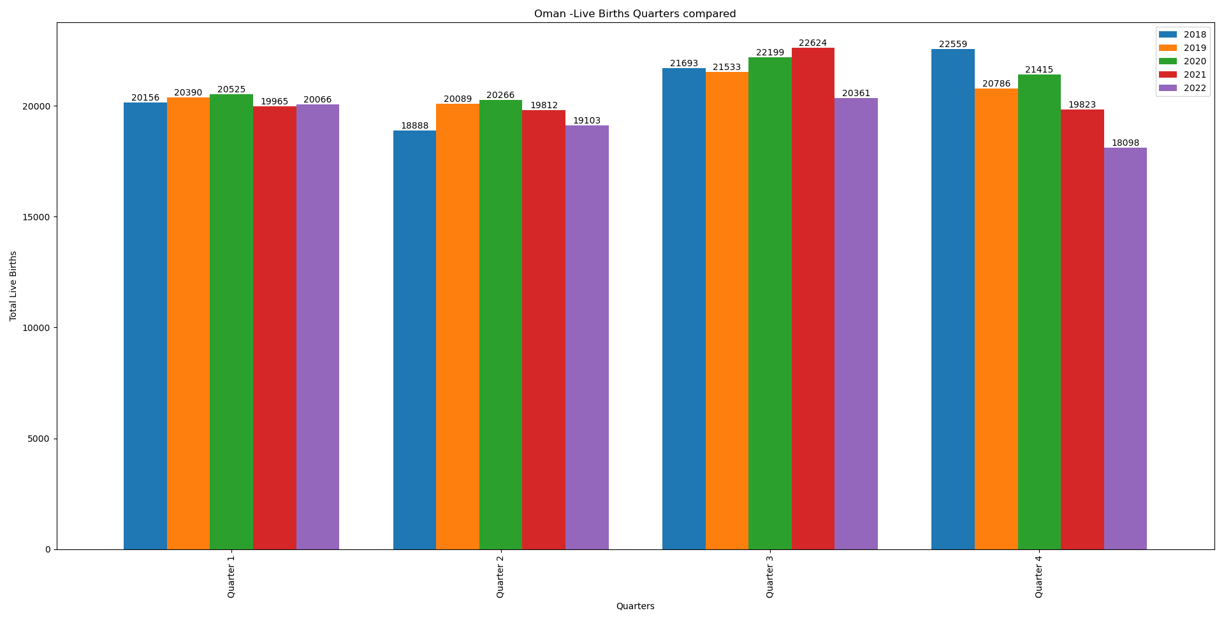
Oman
Started vaccine rollout from ?
A dip can be seen in the months mar-may 2021

Slide 10
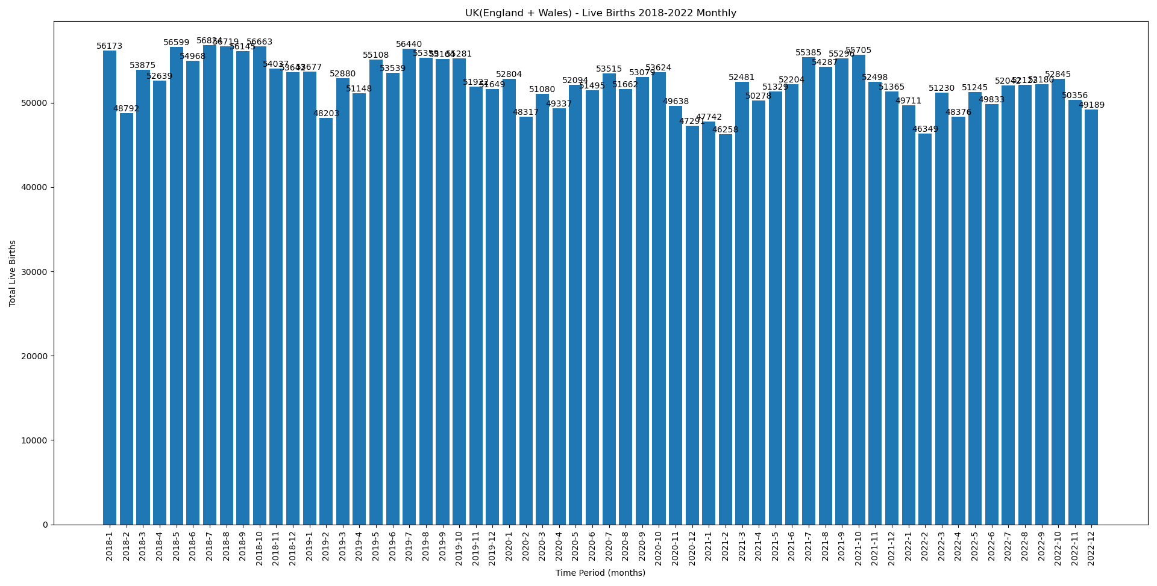
UK (England + wales)
Started vaccine rollout from april-Jun 2021
dip in the months of Jan, feb, april 2022

Slide 11
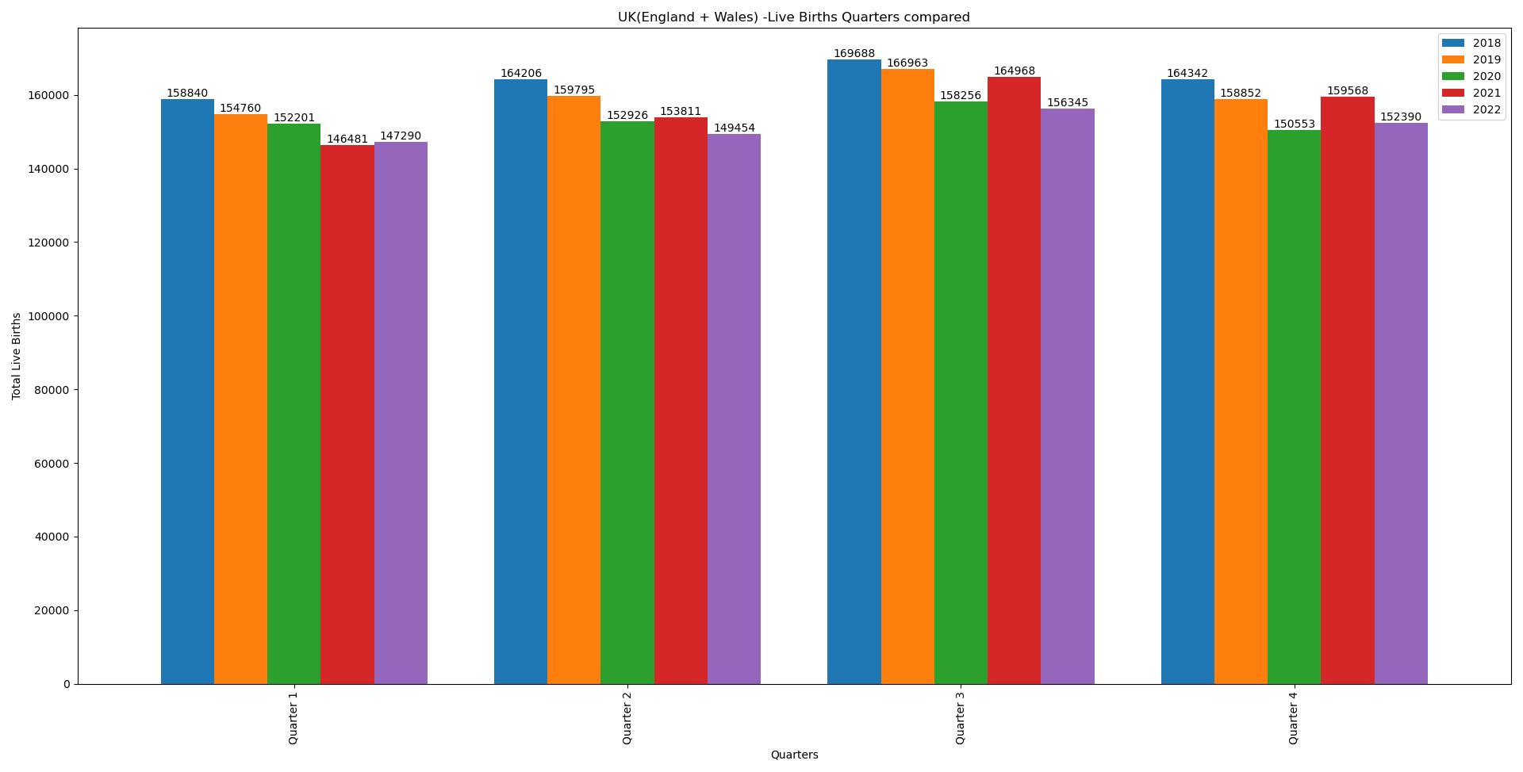
UK (England + wales)
Started vaccine rollout from april-Jun 2021

Slide 12
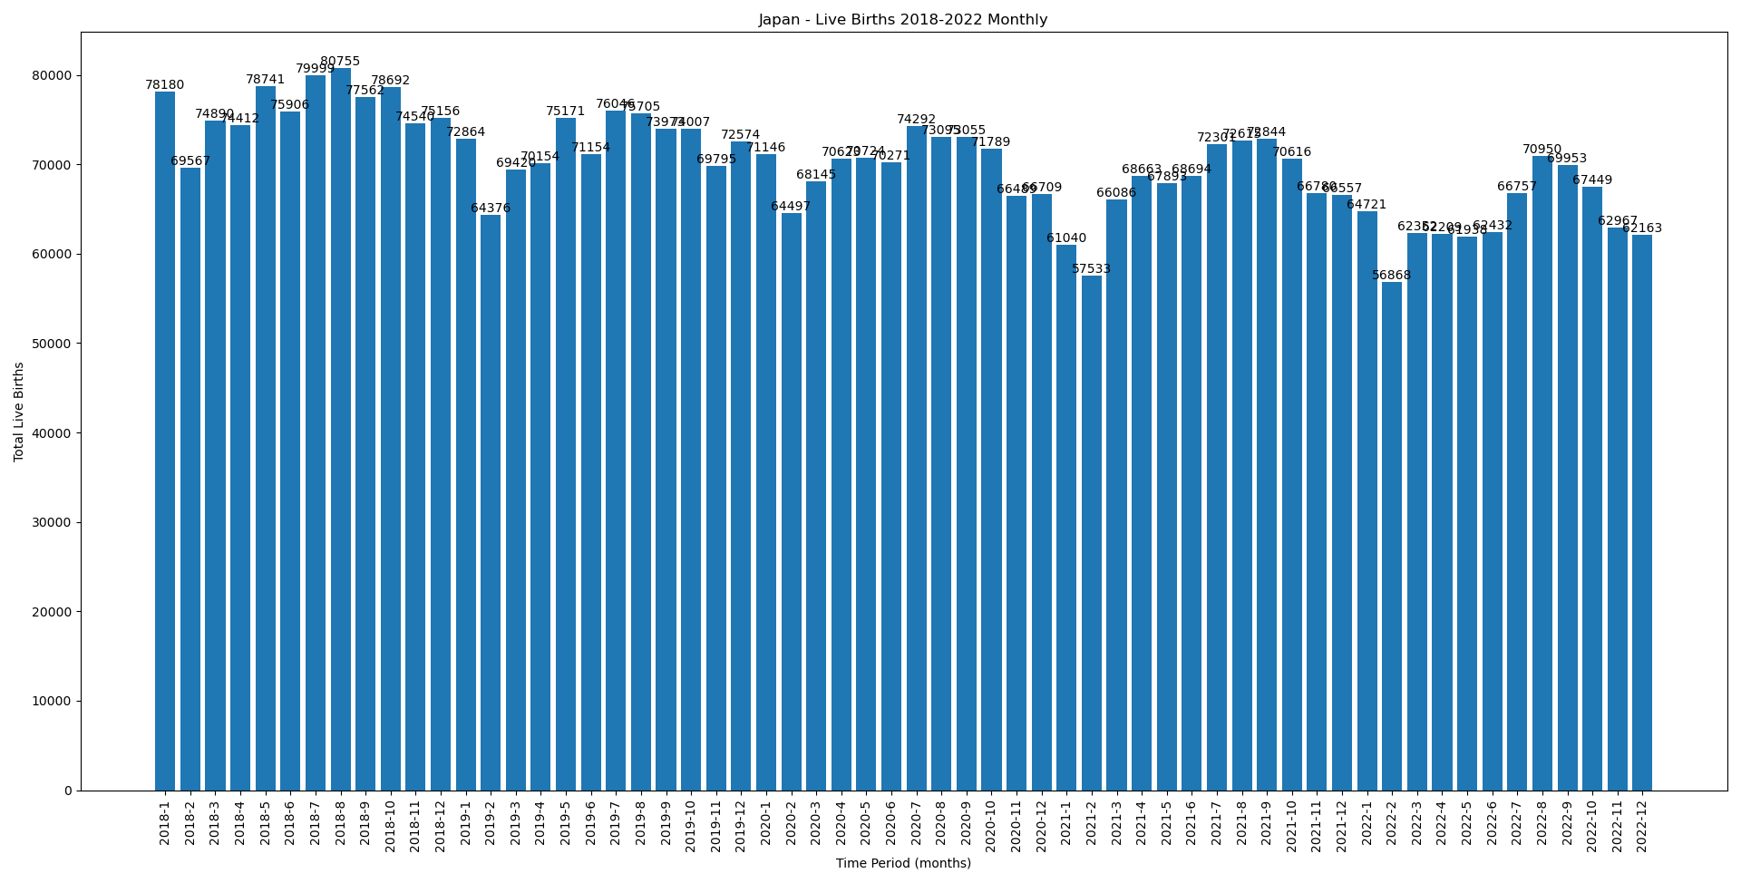
Japan
Started vaccine rollout from ?

Slide 13
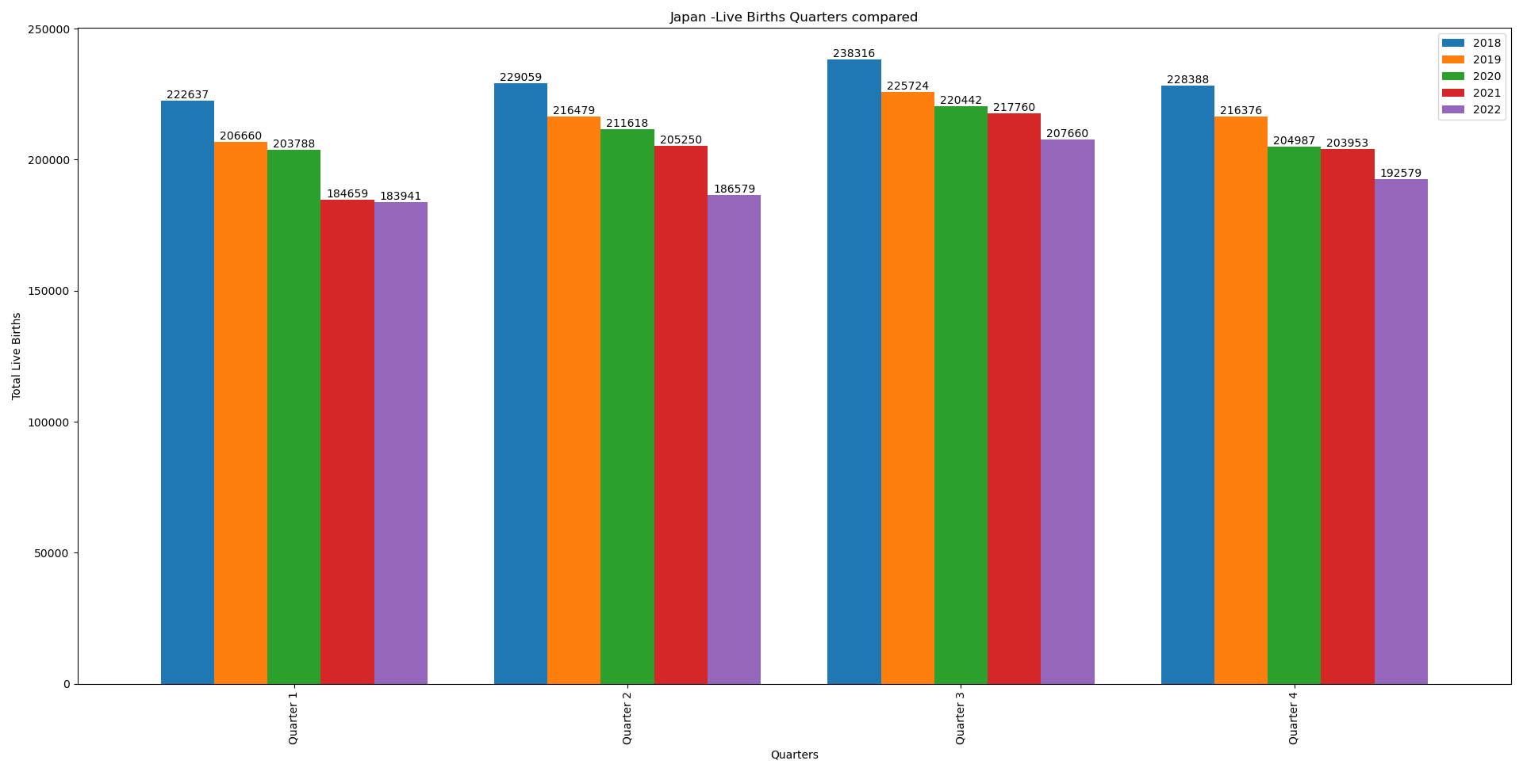
Japan
Started vaccine rollout from ?

Slide 14

Japan
Started vaccine rollout from ?

Slide 15
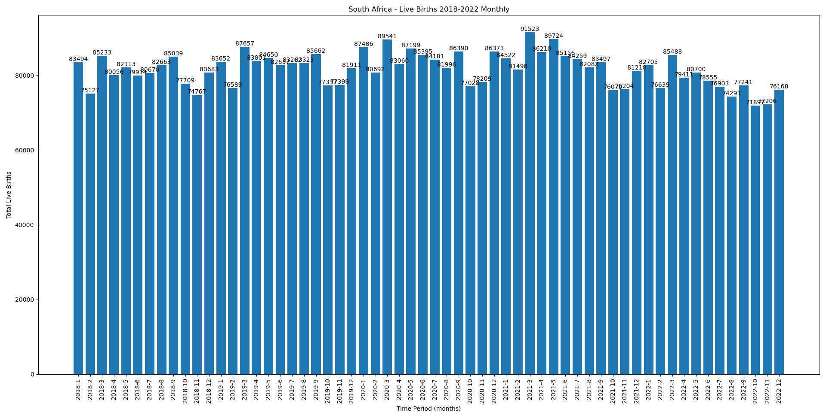
South Africa
Started vaccine rollout from Jul-2021 for 35-49 and Aug-2021 for 18-34

Slide 16
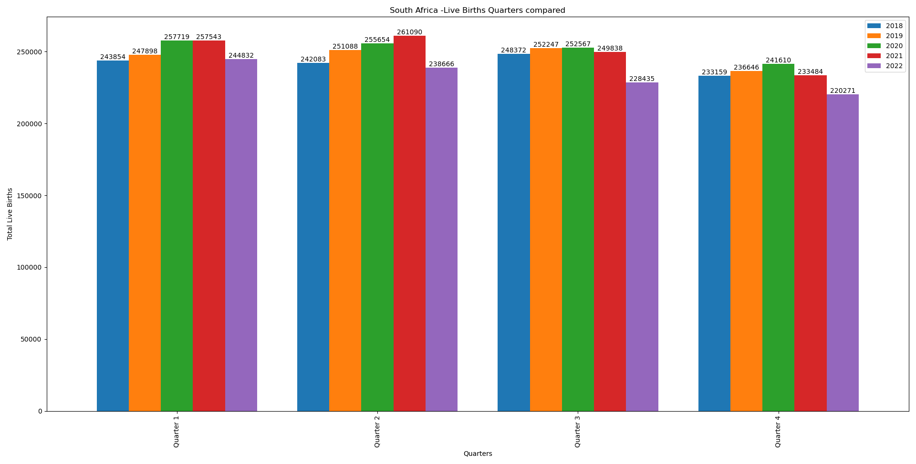
South Africa
Started vaccine rollout from Jul-2021 for 35-49 and Aug-2021 for 18-34
dip in the months apr-may 2022, Q2-2022

Slide 17
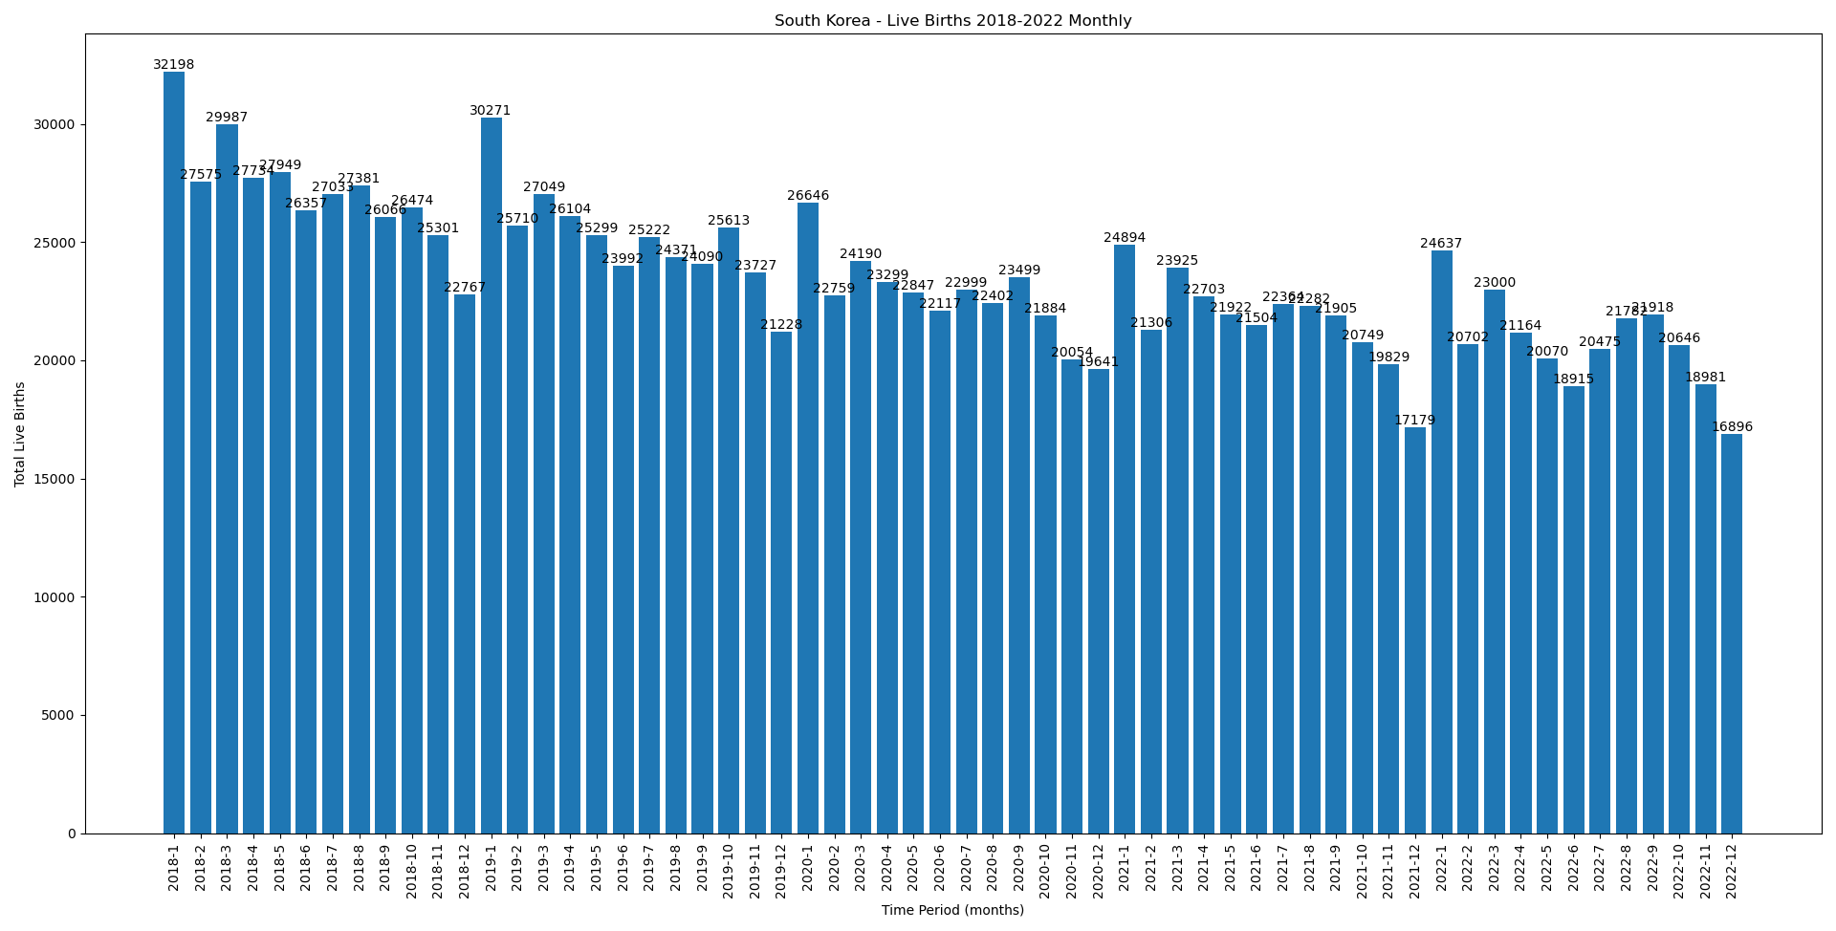
South korea
Started vaccine rollout from feb-2021
Very large dip in the month of Dec-2021

Slide 18
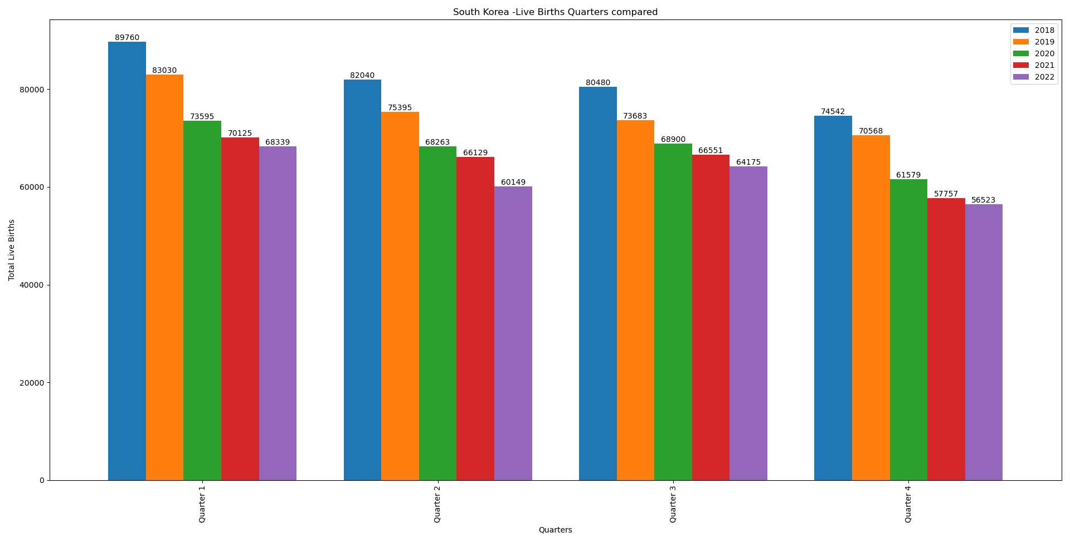
South korea
Started vaccine rollout from Feb-2021

Slide 19
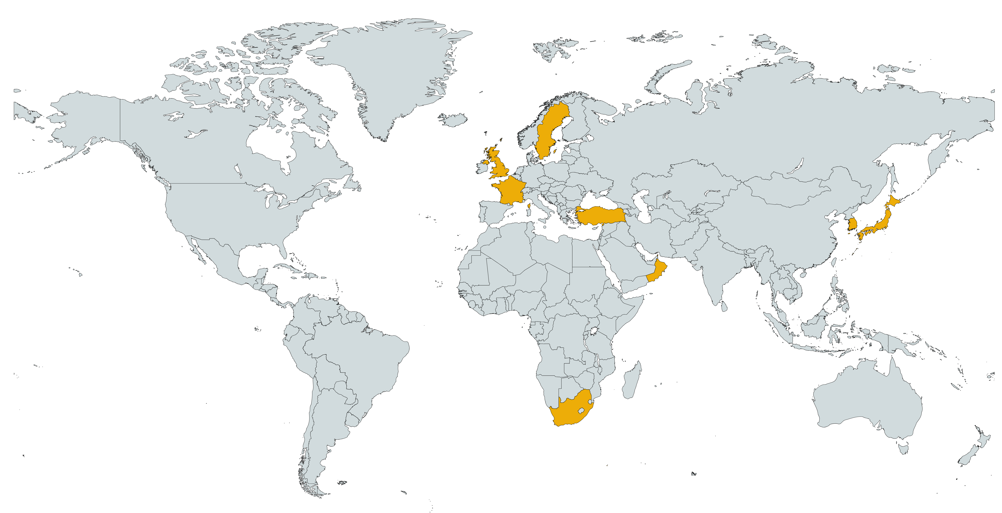
UK : Started vaccination from apr-jun 2021
Sweden : started vaccination from Jun-2021
South Korea: started vaccinations from
Ireland: Started vaccination may-2021
Japan: Started vaccinations
Oman: Started Vaccinations
France : Started Vaccinations apr-2021
Turkiye: started vaccinations ?
South Africa: started Vaccinations jul-Aug 2021

Slide 20
Covid Infographics
Jupiter is a gas giant and the biggest planet in the Solar System
56%
Mercury is the closest planet to the Sun and is the smallest one
12%
It has a beautiful name and is the second one in the Solar System
84%

Slide 21
Covid Infographics
13,14 m
Mercury it’s the closest planet to the Sun
97,55 m
Earth is the third planet from the Sun
10,88 m
Despite being red, is actually a cold place

